Slide 1
Database Modelling
Week 2
Dr. Farshid Keivanian

Slide 2
Week 2 overview
What is a Data Model?
Why Do We Need It?
The 3 Main Types of Data Models
The Relational Model – The Heart of Modern Databases
Relational Table Basics
Relationships – Connecting the Dots
Tools for Drawing ERDs
Using Microsoft Visio for ERD Diagrams
Research Discussion Questions & Sample Responses
Problem-Solving Activity – Relationships (5 minutes)
Understanding Primary and Foreign Keys
Understanding Relationships and Cardinality
Week 2 Practice Questions with Model Answers
Week 2 Tutorial Q1 to Q6
Review and Feedback Tutorial Week 1
Submission of Tutorials & Assessments

Slide 3
What is a Data Model?
Think of a data model as an architect’s plan, but instead of planning a building, we’re planning a database. It’s the blueprint that says:
What data will be stored
How that data connects to other data

Slide 4
Why Do We Need It?
Without a data model, building a database is like trying to build a house without any plans — you’ll probably waste time, money, and end up with a mess. A data model helps us:
Stay organised
Avoid confusion
Make sure the system works the way we want

Slide 5
The 3 Main Types of Data Models
Conceptual Model – The Big Picture
Focuses on entities (things we store data about) and their relationships
Usually shown with an ERD (Entity Relationship Diagram)
No technical detail yet — just the overall view

Slide 6
The 3 Main Types of Data Models
2. Logical Model – More Details
Adds attributes (properties of each entity)
Defines keys (like student IDs) and rules
Still not about the actual storage, but much closer to the real thing

Slide 7
The 3 Main Types of Data Models
3. Physical Model – How It’s Actually Stored
Shows exactly how the database will be built in a specific system (like MySQL or Azure SQL)
Includes tables, column names, data types, indexes, and how it’s stored in hardware/software

Slide 8
The 3 Main Types of Data Models
Analogy – Building a House
Conceptual = Rough sketch of where rooms will be
Logical = Exact measurements and materials list
Physical = Laying bricks, wiring the house, installing plumbing

Slide 9
The Relational Model – The Heart of Modern Databases
What is it?
The relational model organises data into tables (we also call them relations).
Each row is a record — or in database terms, a tuple.
Each column is an attribute — or simply a field.

Slide 10
The Relational Model – The Heart of Modern Databases
How it works:
Tables can be linked using keys (like Student ID, Medicare Number, etc.).
These links let us pull related data together without storing it twice.

Slide 11
The Relational Model – The Heart of Modern Databases
Why it’s awesome:
Reduces redundancy – no need to repeat the same info in multiple places
Easy to query – we can find what we need using SQL
Flexible – we can add new data without redesigning everything

Slide 12
The Relational Model – The Heart of Modern Databases
Analogy: Imagine different sheets in Excel that share a common column. Example: One sheet has student details, another has their enrolments, both linked by Student ID.

Slide 13
The Relational Model – The Heart of Modern Databases
Australian Example: Think about Medicare:
One table stores Patients (name, date of birth, Medicare number)
Another table stores Appointments (date, doctor, clinic, Medicare number)
The Medicare Number links them together so we can see which patient has which appointments

Slide 14
Relational Table Basics
What’s in a relational table?
Each row = one record (e.g., one student)
Each column = one attribute (e.g., Name, Date of Birth)
All values in a column must be the same data type (e.g., all dates, all numbers, all text)
Each column has a domain – the set of allowed values (e.g., GPA can only be between 0.0 and 7.0)
Order doesn’t matter – the sequence of rows or columns doesn’t change the meaning of the data

Slide 15
Relational Table Basics
Analogy: Think of a cricket team list:
Each row is a player
Each column is a detail about that player — name, position, jersey number
All jersey numbers are numbers, all positions are text, etc.

Slide 16
Relational Table Basics
Australian Example: At ACU, the Semester 2 Enrolment Table might have:
Rows: Each enrolled student
Columns: Student ID, Name, Degree, Campus, Units Enrolled

Slide 17
Relationships – Connecting the Dots
What are relationships in a relational database?
They describe how data in one table is connected to data in another.
The 3 main types:
One-to-One (1:1)
One student has one ID card
Each side matches to only one record on the other side

Slide 18
Relationships – Connecting the Dots
One-to-Many (1:M)
One course has many students
Common in real databases — one “parent” record, many “child” records
Many-to-Many (M:N)
Students enrol in many courses, and each course has many students
Needs a bridge (junction) table to make it work in a relational database

Slide 19
Relationships – Connecting the Dots
Analogy – Sports Teams:
1:M → One coach manages many players
M:N → A player can play in many matches, and each match has many players

Slide 20
Relationships – Connecting the Dots
Australian Example: Think of the Myki card system in Melbourne:
A traveller can take many trips
Each trip can be taken by many different travellers over time
The system uses linking tables to connect travellers and trips efficiently

Slide 21
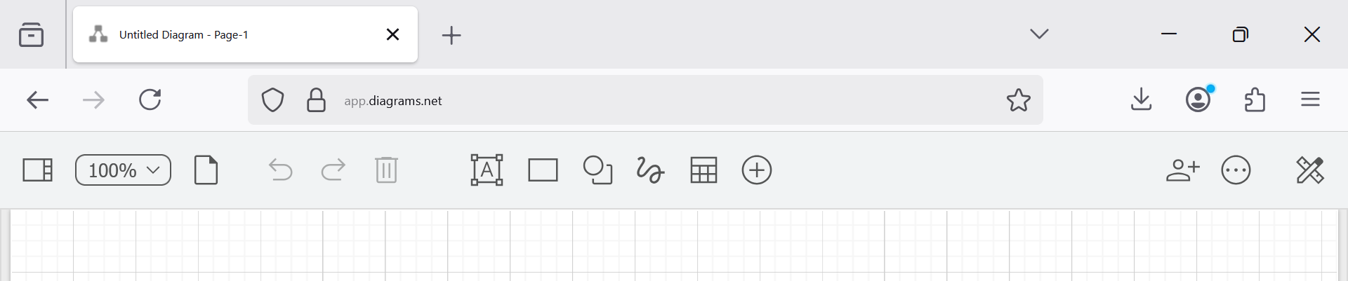
Tools for Drawing ERDs
Popular ERD Tools:
draw.io (also called diagrams.net)
Lucidchart
Creately
dbdiagram.io
Visio Drawing

Slide 22
Tools for Drawing ERDs
Tool | Description | Platform | Best For | Link
Draw.io (diagrams.net) | Intuitive, browser-based diagramming tool with UML templates. | Web, Desktop | Class Diagrams, Use Case Diagrams, Flowcharts | https://draw.io
Lucidchart (Free Plan) | Easy-to-use interface with real-time collaboration and UML templates. | Web | UML diagrams, Use Case design, Group work | https://www.lucidchart.com
Visual Paradigm (Community Edition) | Professional UML and system modeling tool with rich diagram support. | Desktop (Windows/macOS/Linux) | Class Diagrams, Sequence Diagrams, DFDs | https://www.visual-paradigm.com/download/community.jsp
StarUML (Free Trial or License) | Designed for software engineering students and professionals. | Desktop | Full UML diagram suite (recommended in course) | https://staruml.io
Creately (Free Tier) | Collaborative visual workspace with multiple UML templates. | Web | Use Cases, Class Diagrams, ERDs | https://creately.com

Slide 23
Tools for Drawing ERDs
In this unit → draw.io is recommended because:
It’s free
Works in the browser
Saves to OneDrive, Google Drive, Dropbox

Slide 24
Tools for Drawing ERDs
Recommendation for Students
Beginner-friendly: Start with Draw.io or Lucidchart.
Professional-level UML modelling: Use StarUML or Visual Paradigm.
Offline work: Prefer Visual Paradigm or StarUML desktop versions.
Collaboration features: Use Lucidchart or Creately (great for group projects).

Slide 25
Tools for Drawing ERDs
In database design, "Optional" and "Mandatory" terms in cardinality refer to whether an entity is required to participate in a relationship with another entity. Let's explore these with a scenario and step-by-step SQL solution for better understanding.

Slide 26
Tools for Drawing ERDs
Mandatory Many (1) - This means that one entity must have at least one or many associated records in another entity.
Optional Many (0) - This implies that one entity may have none, one, or many associated records in another entity, making participation in the relationship optional.
Mandatory One (1:1) - This indicates that one entity must have exactly one associated record in another entity.
Optional One (0:1) - This means that one entity may have at most one associated record in another entity, but it’s not required.

Slide 27
Using Microsoft Visio for ERD Diagrams
Microsoft Visio can definitely be used to create ERDs.
In fact, Visio has built-in templates for Entity Relationship Diagrams, and if you’re using the Professional or Plan 2 version, it can even reverse-engineer a database (connect to MySQL, SQL Server, etc., and generate an ERD automatically).
However, a few points for students:
Pros: Professional look, lots of shapes, good for formal documentation.
Cons: Paid software (not free), may not be accessible to all students unless the university provides a license.
For class work, draw.io or other free tools are more practical, but Visio is great in industry settings.

Slide 28
Research Discussion Questions & Sample Responses
Concept | Discussion Question | Sample Concise Response
Data Models | How does a conceptual model help avoid costly database redesigns? | It captures requirements early, so we don’t have to redo work later.
Relational Model | Why is the relational model popular in Australian business systems? | It’s flexible, supported everywhere, and works well with reporting tools.
Relational Tables | Why must a column have just one data type? | To keep data consistent, make queries accurate, and avoid errors.
Relationships | Give an Australian example of a many-to-many relationship. | Students and units at ACU – students take many units, units have many students.
ERD Tools | Why use a digital ERD tool instead of paper? | It’s easier to edit, share, and link to database software.

Slide 29

Problem-Solving Activity – Relationships (5 minutes)
Problem: A university needs to track:
Which students take which courses
And when they take them
Your task:
Think about what tables we might need.
What columns should each table have?
How would you connect them?

Slide 30
Problem-Solving Activity – Relationships (5 minutes)
Possible Solution:
1. Students Table
StudentID | Name | Campus | Program
S001 | Mia Jones | Melbourne | IT
S002 | Liam Smith | Brisbane | Business
2. Courses Table
CourseID | CourseName | Credits
IT101 | Intro to IT | 10
BUS102 | Marketing Basics | 10

Slide 31
Problem-Solving Activity – Relationships (5 minutes)
3. Enrolments Table (Bridge table for M:N relationship)
StudentID | CourseID | Semester
S001 | IT101 | S2-2025
S001 | BUS102 | S2-2025
S002 | BUS102 | S2-2025

Slide 32
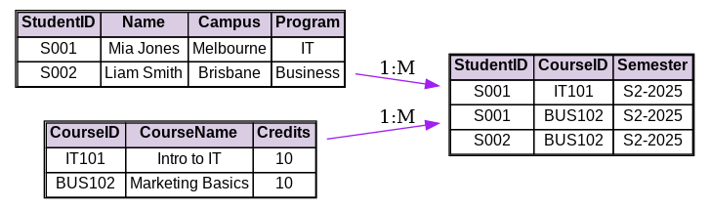
Problem-Solving Activity – Relationships (5 minutes)
Students Table → Each student has a unique StudentID (e.g., S001).
Courses Table → Each course has a unique CourseID (e.g., IT101).
Enrolments Table → Connects students to courses they are taking in a specific semester.

Slide 33
Problem-Solving Activity – Relationships (5 minutes)
Relationships:
One student can have many enrolment records (1:M from Students to Enrolments).
One course can also have many enrolment records (1:M from Courses to Enrolments).

Slide 34
Problem-Solving Activity – Relationships (5 minutes)
Why the middle table is needed:
Students and courses have a many-to-many relationship in real life.
In databases, we handle this by adding a bridge table (Enrolments) that stores both IDs plus extra info (like Semester).

Slide 35
Problem-Solving Activity – Relationships (5 minutes)
Why this works:
Students and Courses have a many-to-many relationship.
Enrolments links them together, while storing extra info (like Semester).

Slide 36
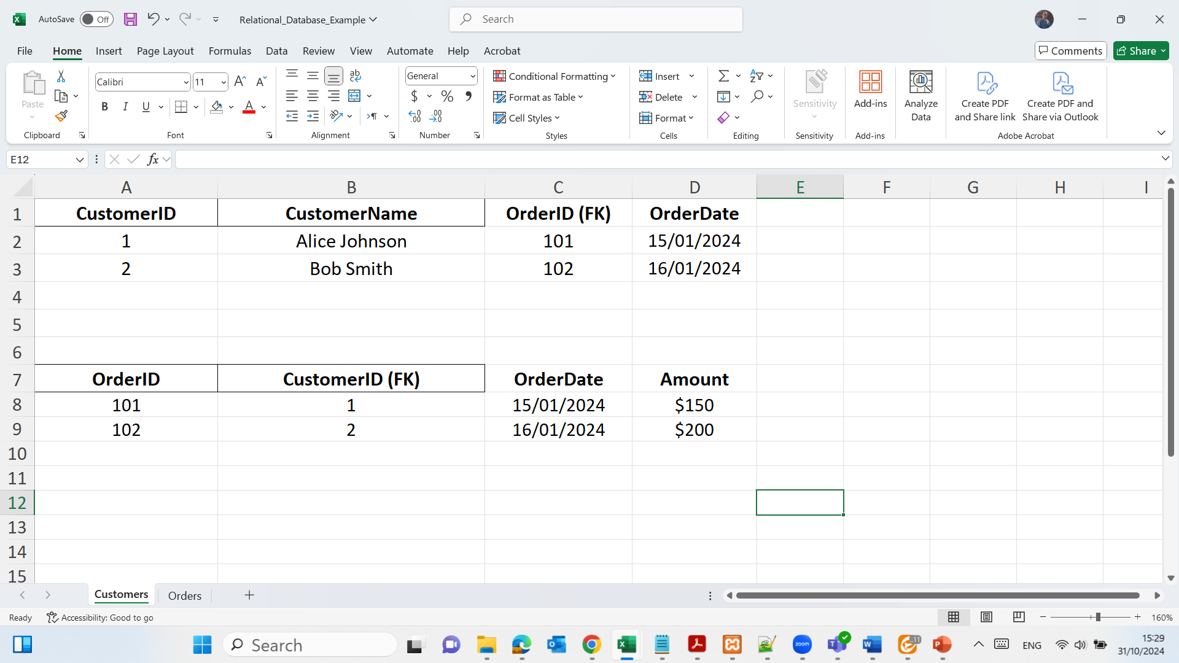
Understanding Primary and Foreign Keys
Objective: Introduce relational database components.
We review the concept of tables and how they are related through keys (primary key, foreign key).

Slide 37
Understanding Primary and Foreign Keys
CustomerID: Primary key for each customer, uniquely identifying each record.
OrderID: Foreign key referencing the primary key in the Orders table, linking each customer to a specific order.
CustomerName and OrderDate: Additional fields providing information about each customer and its order.

Slide 38
Understanding Primary and Foreign Keys
OrderID: Primary key for each order, uniquely identifying each record.
CustomerID: Foreign key referencing the primary key in the Customers table, linking each order to a specific customer.
OrderDate and Amount: Additional fields providing information about each order.

Slide 39
Understanding Primary and Foreign Keys
CustomerID (PK)
OrderID (FK)
----------------------
CustomerName
OrderDate
OrderID (PK)
CustomerID (FK)
----------------------
OrderDate
Amount
Relational Model
Primary Key: Each table has a primary key that uniquely identifies each record. In the Customers table, the primary key is CustomerID. In the Orders table, the primary key is OrderID.
Foreign Key: The CustomerID in the Orders table serves as a foreign key, linking each order to a customer in the Customers table. This creates a relationship between the two tables.

Slide 40
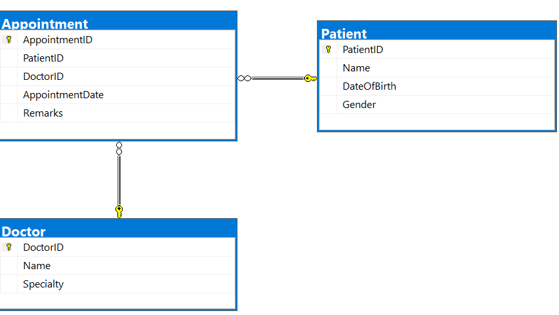
Understanding Relationships and Cardinality
Cardinality:
A patient can have multiple appointments, and each appointment is associated with one patient.
A doctor can have multiple appointments, and each appointment is associated with one doctor.

Slide 41
Week 2 Practice Questions with Model Answers
Practice Set – “DataMartCo” Database
Table 1: REGION
REGION_CODE | REGION_DESCRIPT
10 | Northern
20 | Southern

Slide 42
Week 2 Practice Questions with Model Answers
Table 2: STORE
STORE_CODE | STORE_NAME | STORE_YTD_SALES | REGION_CODE | EMP_CODE
501 | SQL Central | 1,205,340.50 | 10 | 1003
502 | Table Town | 954,200.00 | 20 | 1005
503 | Key Junction | 1,445,990.20 | 10 | 1001

Slide 43
Week 2 Practice Questions with Model Answers
Table 3: EMPLOYEE
EMP_CODE | EMP_TITLE | EMP_LNAME | EMP_FNAME | EMP_INITIAL | EMP_DOB | STORE_CODE
1001 | Mr. | Lopez | Carlos | J | 1990-02-14 | 503
1002 | Ms. | Patel | Aria | K | 1994-08-29 | 503
1003 | Mrs. | Nguyen | Emily | L | 1988-05-22 | 501
1004 | Mr. | Wong | David | M | 1991-11-10 | 501
1005 | Ms. | Martin | Chloe | R | 1987-12-05 | 502
1006 | Mr. | Singh | Aaron | S | 1986-09-17 | 502

Slide 44
Week 2 Practice Questions with Model Answers
Questions
Q1. For each table, identify the Primary Key and any Foreign Key(s). If a table has a foreign key, specify which table/column it references.
Q2. Do the tables exhibit entity integrity? Answer Yes or No for each table and explain briefly.
Q3. Do the tables exhibit referential integrity? Answer Yes or No for each foreign key and explain briefly. Write N/A if the table has no foreign key.

Slide 45
Week 2 Practice Questions with Model Answers
Q4. Describe the relationship(s) between STORE and REGION.
Q5. Draw the ERD showing the relationship between STORE and REGION using Crow’s Foot notation.
Q6. Draw the ERD showing the relationships among EMPLOYEE, STORE, and REGION.

Slide 46
Week 2 Practice Questions with Model Answers
Model Answers
Q1 – PKs and FKs
Table | Primary Key | Foreign Key(s)
REGION | REGION_CODE | None
STORE | STORE_CODE | REGION_CODE → REGION(REGION_CODE) EMP_CODE → EMPLOYEE(EMP_CODE)
EMPLOYEE | EMP_CODE | STORE_CODE → STORE(STORE_CODE)

Slide 47
Week 2 Practice Questions with Model Answers
Model Answers
Q2 – Entity Integrity
REGION: Yes – REGION_CODE is unique & not null.
STORE: Yes – STORE_CODE is unique & not null.
EMPLOYEE: Yes – EMP_CODE is unique & not null.

Slide 48
Week 2 Practice Questions with Model Answers
Model Answers
Q3 – Referential Integrity
STORE.REGION_CODE → Yes – all values (10, 20) exist in REGION.
STORE.EMP_CODE → Yes – all values exist in EMPLOYEE.
EMPLOYEE.STORE_CODE → Yes – all values exist in STORE.
REGION – N/A (no FK).

Slide 49
Week 2 Practice Questions with Model Answers
Model Answers
Q4 – Relationship STORE ↔ REGION
One REGION can have many STORES.
Each STORE belongs to exactly one REGION.
Relationship type: 1:M (REGION → STORE).

Slide 50
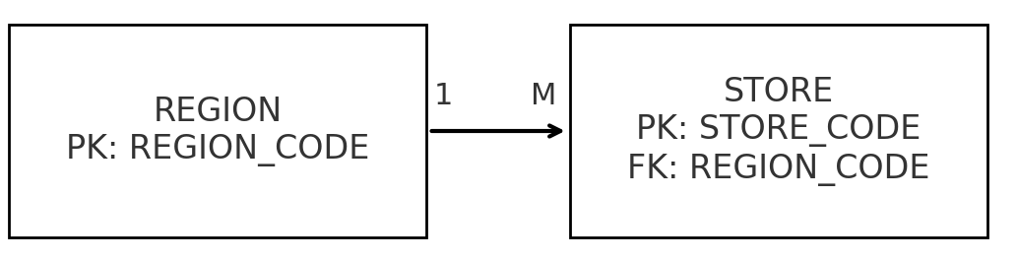
Week 2 Practice Questions with Model Answers
Model Answers
Q5 – ERD STORE ↔ REGION (description)
REGION (PK: REGION_CODE) —< STORE (PK: STORE_CODE, FK: REGION_CODE)
Crow’s Foot at STORE side; PK→FK link from REGION to STORE.
This diagram shows the relationship between REGION and STORE in a database:

Slide 51
Week 2 Practice Questions with Model Answers
REGION_CODE is the Primary Key (PK) in the REGION table – it uniquely identifies each region.
STORE_CODE is the Primary Key in the STORE table – it uniquely identifies each store.
REGION_CODE in the STORE table is a Foreign Key (FK) – it links each store to the region it belongs to.
The 1 → M means one region can have many stores, but each store belongs to exactly one region.
The arrow with the crow’s foot on the STORE side represents the “many” side of the relationship.

Slide 52
Week 2 Practice Questions with Model Answers
Real-world example in Australia: Think of Sydney (Region) having many Woolworths stores, but each store is in exactly one region.

Slide 53
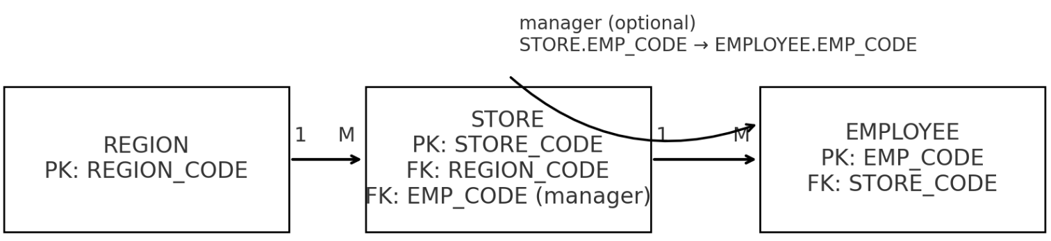
Week 2 Practice Questions with Model Answers
Q6 – ERD EMPLOYEE ↔ STORE ↔ REGION (description)
REGION (1) —< STORE (M) —< EMPLOYEE (M)
FKs: STORE.REGION_CODE → REGION, EMPLOYEE.STORE_CODE → STORE
Optional relationship: STORE.EMP_CODE → EMPLOYEE (manager link).
This diagram shows the relationships between REGION, STORE, and EMPLOYEE in a database:

Slide 54

Week 2 Practice Questions with Model Answers
REGION → STORE
1 → M means one region can have many stores.
STORE.REGION_CODE is a Foreign Key (FK) linking each store to its region.
STORE → EMPLOYEE
1 → M means one store can have many employees.
EMPLOYEE.STORE_CODE is an FK linking each employee to their store.

Slide 55
Week 2 Practice Questions with Model Answers
Manager Link (Optional)
STORE.EMP_CODE → EMPLOYEE.EMP_CODE is an optional link showing that a store can have a manager, who is also an employee in that same store.

Slide 56
Week 2 Practice Questions with Model Answers
Real-world example in Australia: Think of NSW Region having several Coles stores, and each store having many employees. One of these employees might be assigned as the store manager.

Slide 57
Week 2 Practice Questions with Model Answers
Hints for Students
Do: Check PKs are unique & not null before answering entity integrity. Do: Cross-check FK values exist in parent table for referential integrity. Avoid: Assuming a relationship is M:N without checking the data. Do: Use clear PK→FK notation in ERDs.

Slide 58
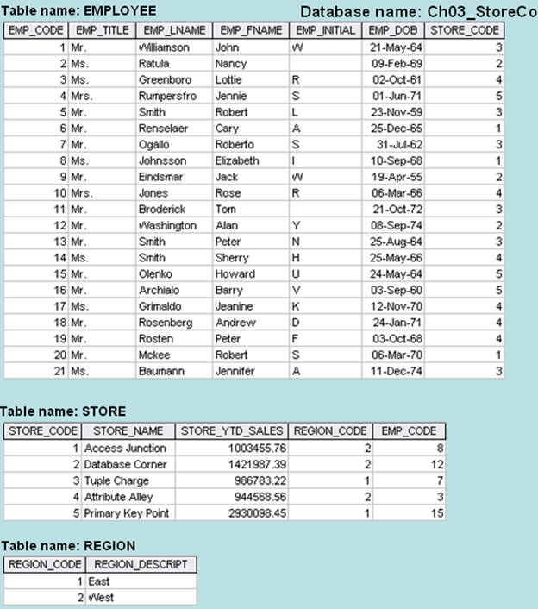
Week 2 Tutorial Q1 to Q6
Q1. For each table, identify the primary key and the foreign key(s). If a table does not have a foreign key, write None.

Slide 59
Week 2 Tutorial Q1 to Q6
A1. Primary keys and foreign keys
REGION
PK: REGION_CODE
FK: None
STORE
PK: STORE_CODE
FKs: REGION_CODE → REGION(REGION_CODE); EMP_CODE → EMPLOYEE(EMP_CODE) (store manager)
EMPLOYEE
PK: EMP_CODE
FK: STORE_CODE → STORE(STORE_CODE)

Slide 60
Week 2 Tutorial Q1 to Q6
Q2. Do the tables exhibit entity integrity? Answer yes or no and then explain your answer.
A2. Yes for all three tables. Each table’s primary key column is present, unique, and not null in the rows shown.

Slide 61
Week 2 Tutorial Q1 to Q6
Q3. Do the tables exhibit referential integrity? Answer yes or no and then explain your answer. Write NA (Not Applicable) if the table does not have a foreign key.
A3) EMPLOYEE.STORE_CODE → all values (1–5) exist in STORE: Yes
STORE.REGION_CODE → only 1 or 2, both exist in REGION: Yes
STORE.EMP_CODE → values {8,12,7,3,15} exist in EMPLOYEE: Yes
REGION has no FK: N/A

Slide 62
Week 2 Tutorial Q1 to Q6
Q4) Describe the type(s) of relationship(s) between STORE and REGION.
REGION 1 : M STORE One region has many stores; each store belongs to exactly one region.

Slide 63
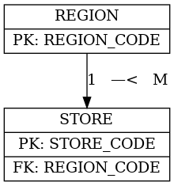
Week 2 Tutorial Q1 to Q6
Q5) Create the ERD to show the relationship between STORE and REGION.
Use Crow’s Foot: REGION (1) —< STORE (M), PK→FK on REGION_CODE.

Slide 64
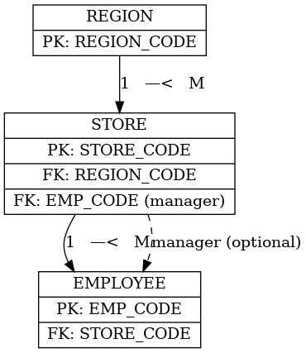
Week 2 Tutorial Q1 to Q6
Q6) Create the ERD to show the relationships among EMPLOYEE, STORE, and REGION.
REGION (1) —< STORE (M) —< EMPLOYEE (M)
FKs: STORE.REGION_CODE → REGION, EMPLOYEE.STORE_CODE → STORE
Optional manager: STORE.EMP_CODE → EMPLOYEE.EMP_CODE (dashed link)

Slide 65
Week 2 Tutorial Q1 to Q6
Manager (optional) means a store can have a manager, but it’s not mandatory to assign one in the database.
The dashed line shows that this is an optional relationship — the EMP_CODE in the STORE table may be empty (NULL) if no manager is assigned.
If there is a manager, that EMP_CODE must match one of the employees in the EMPLOYEE table.
This lets the system record “which employee manages this store” only when applicable.
It’s optional because sometimes the store might not yet have a manager assigned.

Slide 66

Review and Feedback Tutorial Week 1
This week and next week, I will review a few student submissions for Tutorial Week 1. This will help highlight common strengths and specific errors so you can better understand how to improve. Once the review is completed, all results and feedback will be published.

Slide 67
Submission of Tutorials & Assessments
These guidelines are designed to support your learning and help you apply necessary techniques effectively. Please do the remaining problems/tasks and follow the instructions based on Canvas. If you have any questions, feel free to ask—I’m happy to help!

Slide 68
Thank You
Have a Great Learning Day!
Feel free to reach out with any questions!
Dr. Farshid Keivanian

